Slide 1
An Explanation for Sharon
Words and Pictures Case Example
Andrew Turnell

Slide 2
This is a story to explain to Danny, Tori and Sharon why Sharon wasn’t living with the family when she was little.
Daddy
Mummy
Danny
6
Tori
4
Sharon
2

Slide 3
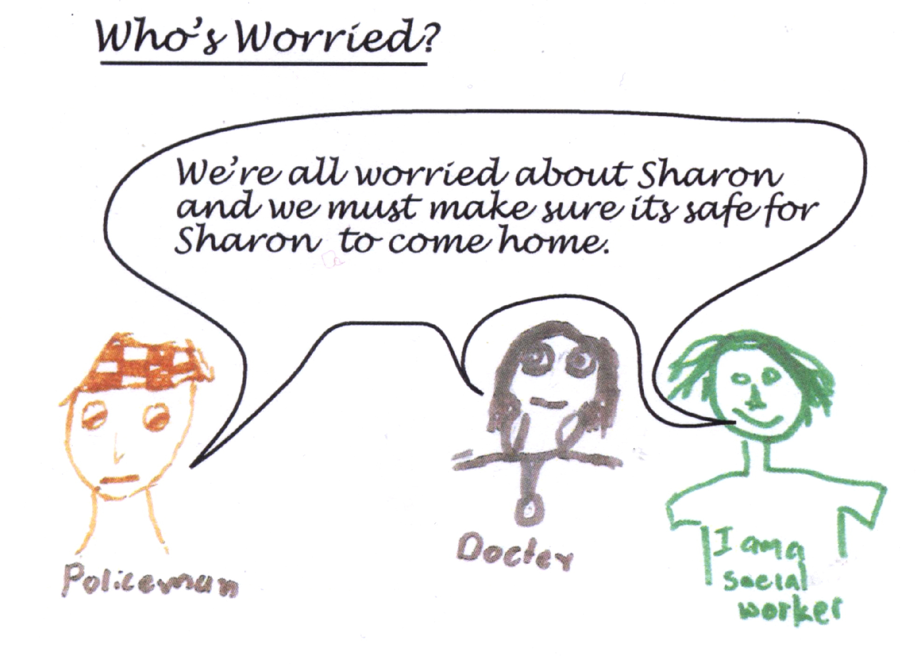

Slide 4
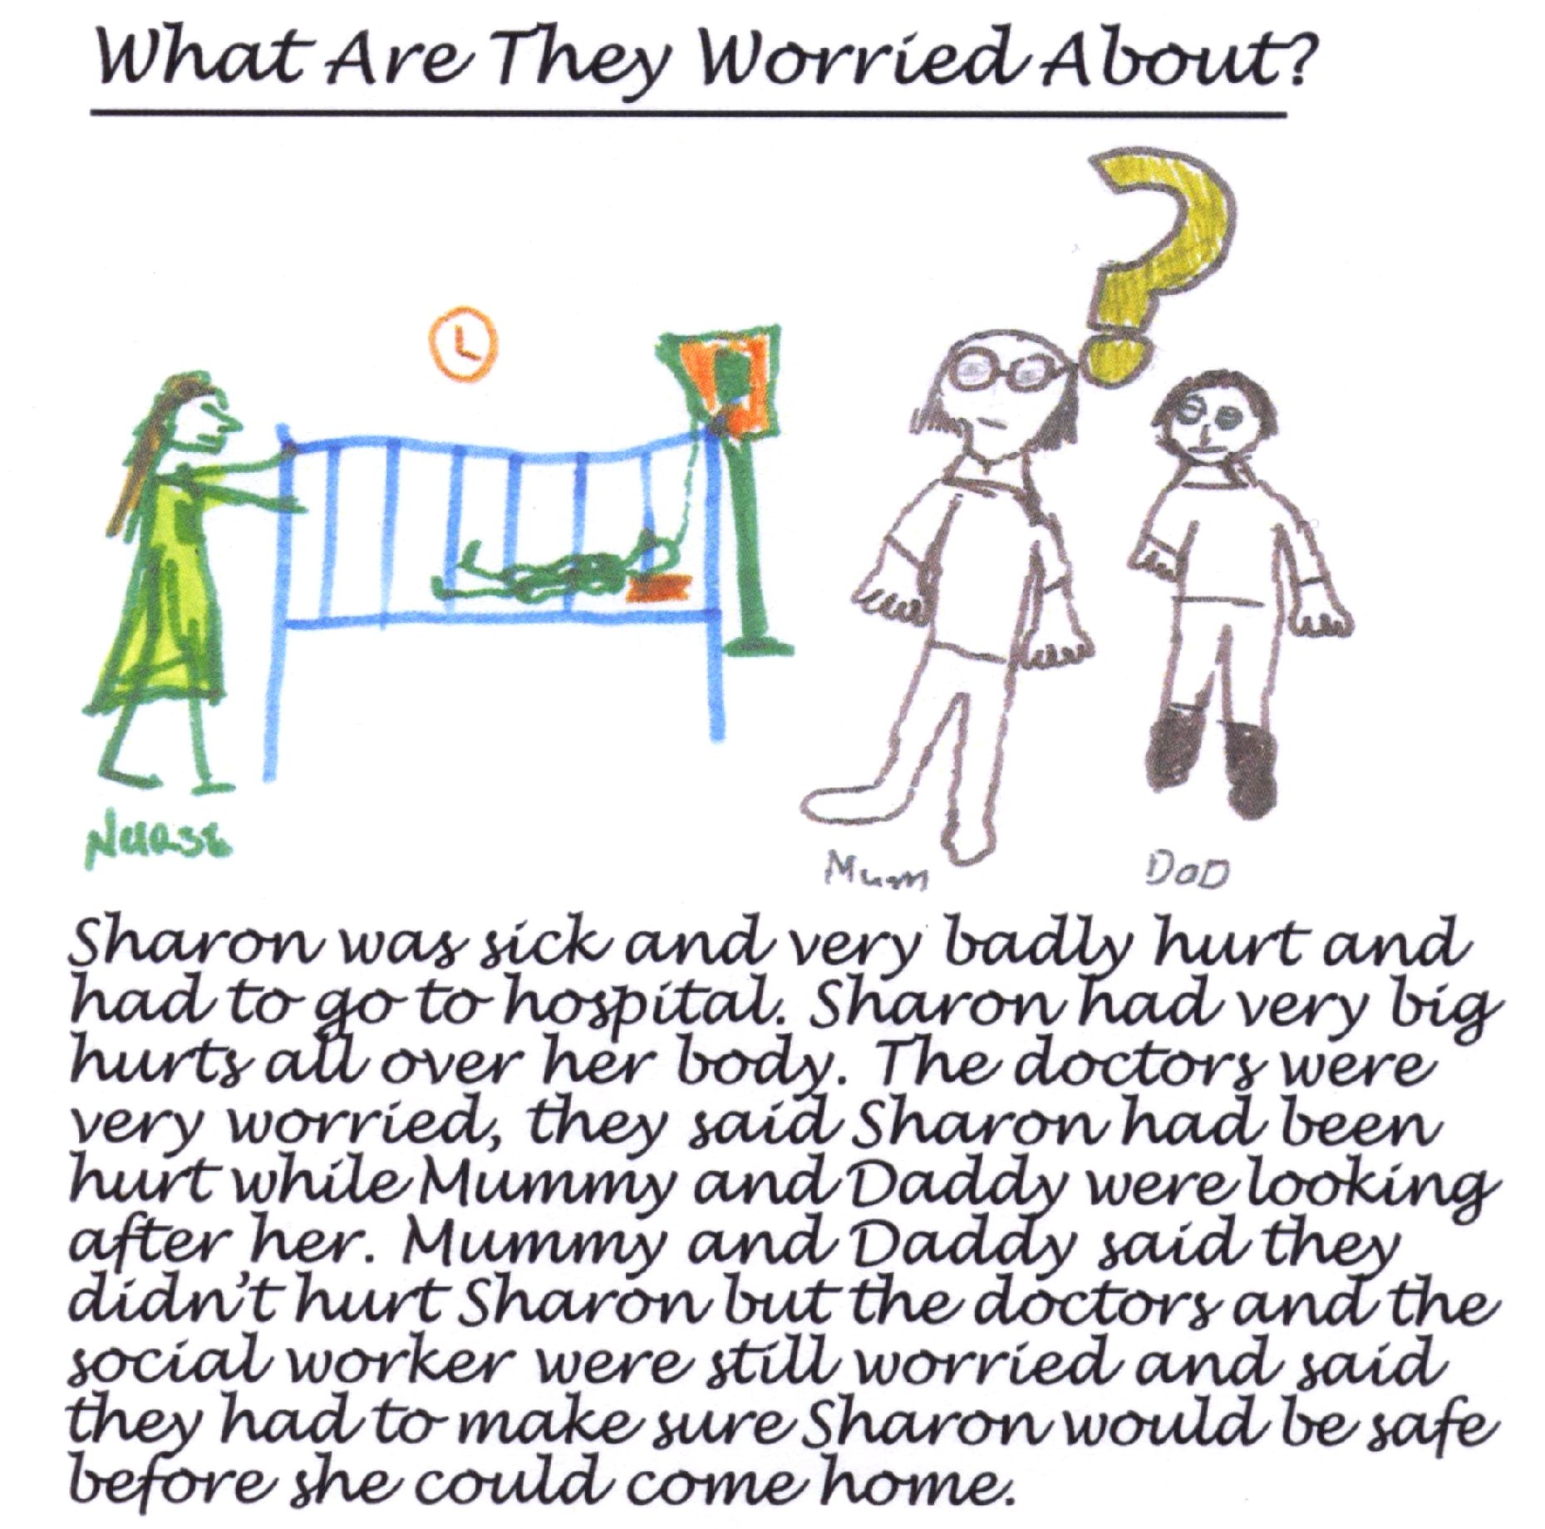
Sharon was sick and very badly hurt and had to go to hospital. Sharon had very big hurts all over her body. The doctors were very worried they said Sharon had been hurt while Mummy and Daddy were looking after her. Mummy and Daddy said they didn’t hurt Sharon, but the doctors and the social worker were still worried and said they had to make sure Sharon would be safe before she came home.

Slide 5
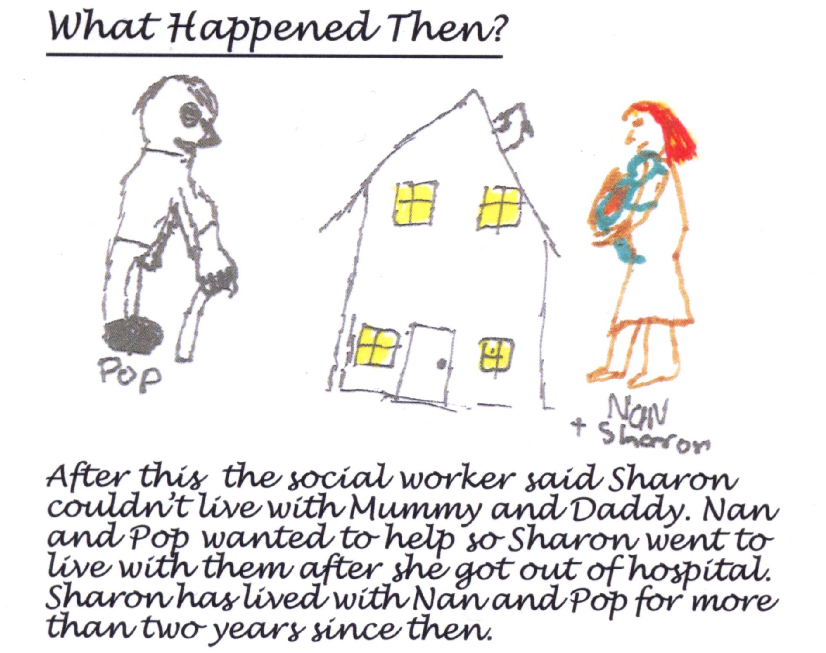
After this the social worker said Sharon couldn’t live with Mummy and Daddy. Nan and Pop wanted to help so Sharon went to live with them after she got out of hospital. Sharon has lived with Nan and Pop for more than two years since then.

Slide 6
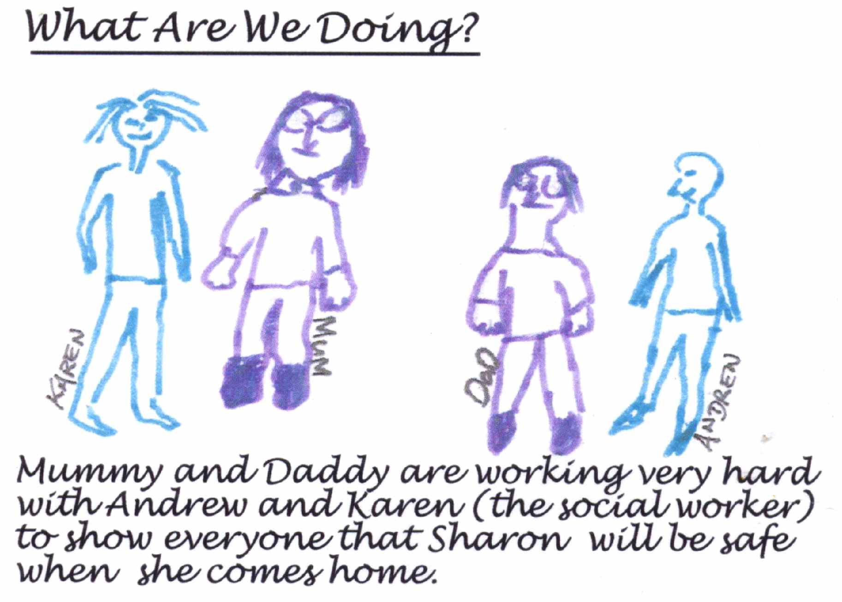
Mummy and Daddy are working very hard with Andrew and Karen (the social worker) to show everyone that Sharon will be safe when she comes home.

